Slide 1
2021 MLP Progress Robotic Mobile Fulfillment System
Yonsei University
Machine Learning Project Team 09
2021.04.09

Slide 2

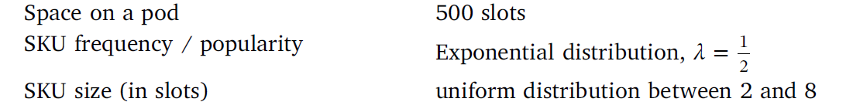
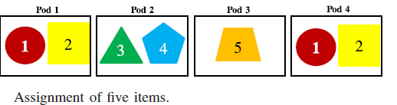
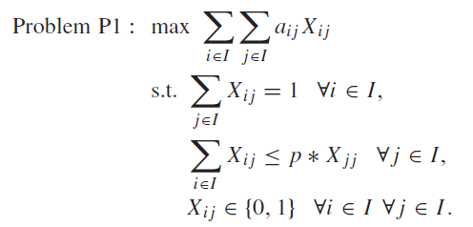
Proposal - Review
Existing Research
“Decision rules for robotic mobile fulfillment systems” , M.Merschformann,…
Set in the Orders tap in RAWSIM-O
Set SKU size, item distribution, Order distribution
Uniform distribution, SKU size is 2~8 items in this paper
Item Classification is distributed in pods according the set distribution, but not applicated in a pod
“Item Assignment Problem in a Robotic Mobile Fulfillment System”, Hyun-Jung Kim..
Calculate Similarity value of Items from Frequency (Clustering)
Maximize the Sum of similarity values
Optimization Algorithm : Heuristic Algorithm ( to revise the varied similarity)
Re-optimization Algorithm (to representation item)

Slide 3
Proposal summery 1
Item pod assignment
Develop initial state
Classification based on frequency, similarity, importance
Apply similarity value of more than three Items
Store on A Pod based on classification and similarity value
Algorithm
Constructive Heuristic : Select High Demand Item
Heuristic Initialization Extensions : Select Representation Item based on matrix
Re-optimization Heuristic
Related papers
“Item Assignment Problem in a Robotic Mobile Fulfillment System”, Hyun-Jung Kim..

Slide 4
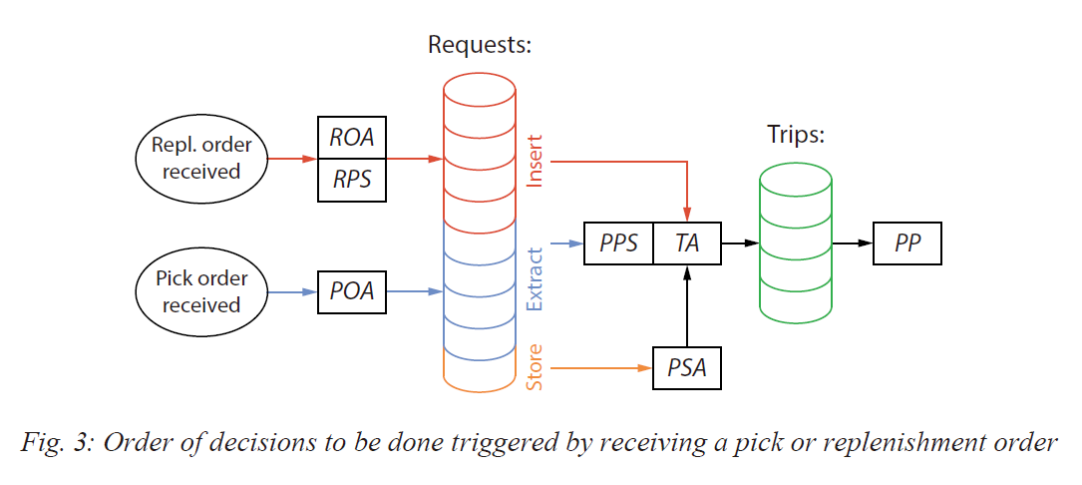
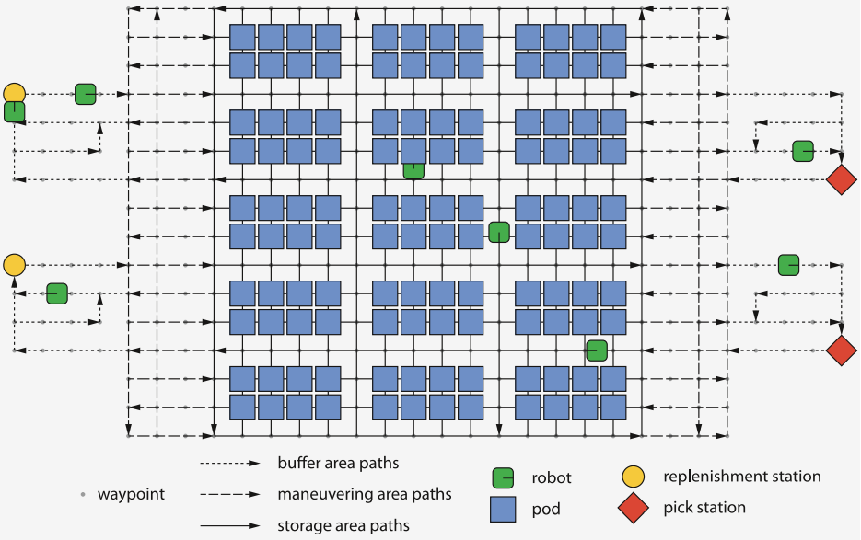
Proposal summery 2
PSA¹ decision rules by ML
Which part of the storage is more efficient when Pods go back to storage area
Input (Features)
Frequency(the number of pick order, Replenishment order)
Remaining items in a Pod
Output
3 part of the storage area as outputs
In RAWSIM-O, 5 mode for PSA
Random, Fixed, Nearest, Station-Based, Class

Slide 5
Proposal summery 3
Association of items
Through the Market basket analysis (Kaggle data)
Add Pod Storage Assignment Decision Rules
2 Constraints
Place the related product nearby
Place the unrelated products faraway
Algorithm
Apriori Algorithm
finde frequent item sets in a data using prior knowledge of frequent itemset properties.
Limitiation : Slow for large item sets
Restricted Boltzmann machines
Hruschka, H. (2014). Analyzing market baskets by restricted Boltzmann machines. OR spectrum, 36(1), 209-228.
Using Neural Network

Slide 6
Proposal suggestion
Idea selection
Integrate 1 and 3 (Classification)
Item pod assignment & Association of items
A Pod selection based on similarity (items)
Pods arrangement based on association (pods) → Require several mobile robot
Selection based on performance comparison (Choose one)
Or Make a related pod through Market basket analysis (Integrate)
Make a order
Item pod assignment → Association of Items(& PSA) → Decision Rule
Classification (Association of Items)
Clarify all the stock Code (# and type of items)
Make a related weight based on Customer ID
Other features
Quantity
Period based on InvoiceDate

Slide 7
Proposal Discussion
How to compare ?
Analysis for RAWSim-O
Control Group vs Experiment Group
w/o change
Only PSA or Only classification
Both PSA and Classification
How to Apply
Classification → Apply results as make an instance
PSA...?
Decision Rule
Arrangement of pods (PSA) vs Arrangement of robots (TA)
Algorithm

Slide 8
Proposal 2 – Item classification
Suggestion
Develop Initial State
Classification Based on Frequency, Similarity, Importance etc.
Find optimal Classification model
Using Classification algorithm with proper weight
Learning classification model from other Input as well as Frequency
Apply similarity value of three Items rather than just two
Use not A Pod, but several Pods
Store on a Pod based on Classification
Change classification when changing Similarity
Algorithm
Constructive Heuristic : Select High Demand Item
Heuristic Initialization Extensions : Select Representation Item based on matrix
Re-optimization Heuristic
Notes:
이 논문에서 초기 constructive heuristic을 기초로 확장한알고리즘 하나, reoptimization heuristic 하나 이렇게 두가지 변형 알고리즘이 있습니다.
Const H : 한 아이템의 주문 수(임의지정) 기준->대표 아이템(high demend되는 경우O)을 기준으로 다른 아이템들과의 각각의 similarity value 계산(그룹당 아이템갯수 정해져있음)
Heuristic Ini Exten: 1에서 초기rule 적용: 두가지 아이템을 한꺼번에 주문하는 주문 수의 평균 기준, 한 아이템에 대해 similarity value를 최댓값 사용
Reoptim H : 기존 solutio을 이용해서 다른 solution 찾기, similarity가 커지고 작아지는거에 따라서 다른 해를 찾는 것임.
Use Not a pod, 이 논문 내용이 한 포드 안에 여러 아이템을 분류해서 넣는 것 까지입니다. 그래서 우리는 여러 개의 포드 안에 여러 아이템을 분류해서 넣고자 하는 것.

Slide 9
Proposal 2 – Item classification
Suggestion
Develop Decision Rule Modeling by Machine Learning
Add Pod Storage Assignment Decision Rules¹
In RAWSIM-O, There are 5 mode for PSA
Random, Fixed, Nearest, Station-Based, Class
Which part of the Storage is more efficient when Pods go back to Storage area
Frequency(the number of Pick order, Replenishment order), Remaining items in a Pod as features
3 part of the storage area as outputs

Slide 10
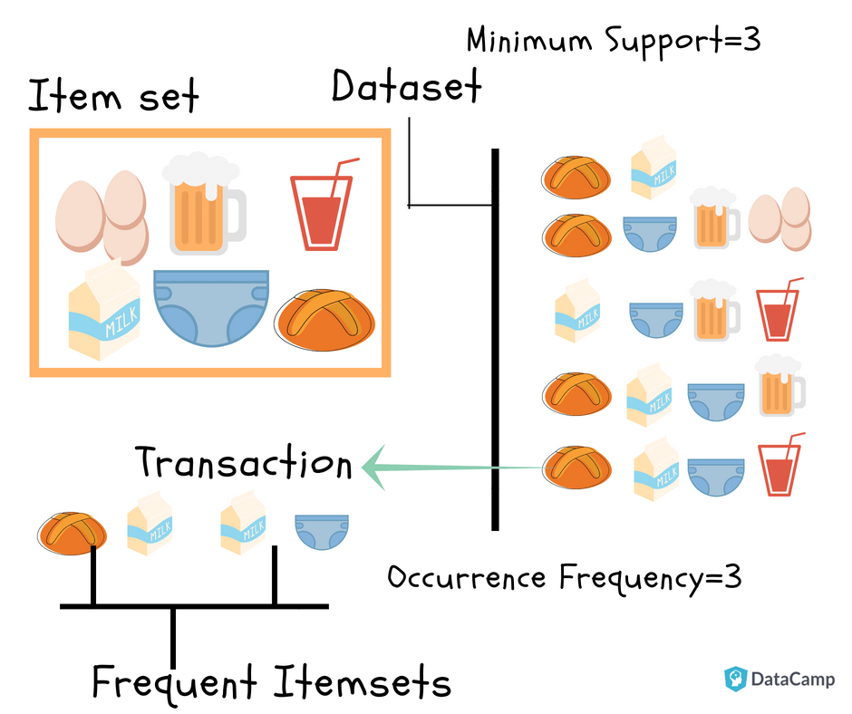
Proposal 2 – Item classification
Suggestion
Find association of products through the Market basket analysis
Add Pod Storage Assignment Decision Rules¹
2 Constraints
Place the related product nearby
Place the unrelated products faraway

Slide 11
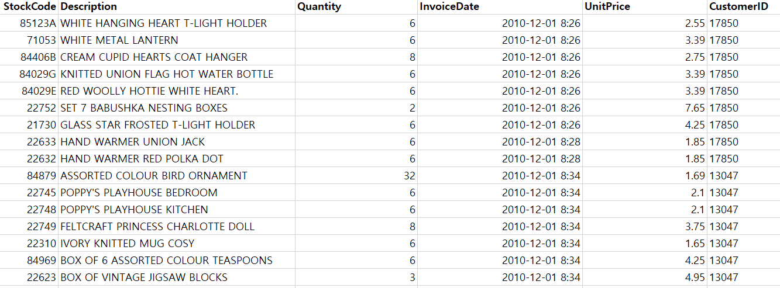
Proposal 2 – Item classification
Dataset (from Kaggle)
Online Retail (https://www.kaggle.com/puneetbhaya/online-retail)
Product ID
Product Name
Customer ID
Σ (# of Product ID with the same customer ID) = Shopping cart of one person

Slide 12
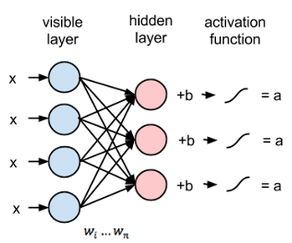
Proposal 2 – Item classification
Market Basket Analysis
Apriori Algorithm
finding frequent item sets in a dataset using prior knowledge of frequent itemset properties.
Limitiation : Slow for large item sets
Hruschka, H. (2014). Analyzing market baskets by restricted Boltzmann machines. OR spectrum, 36(1), 209-228.
Using Neural Network
Benefit
Reduce unnecessary movement of the robot
Raise Efficiency of the Path Planning
Limitation
Dataset is about online retail NOT about Customer
Need to find algorithm to optimize the hyperparameter
Notes:
Frequent Item set :
자주 등장하는 아이템 셋 (예를 들어서 11p의 사진을 보시면 [빵, 우유] 같은 것이 frequent item set이 됩니다.) 이걸 통해서 아이템끼리의 연관성을 찾아가려고 하는 것입니다.
RBM:
pattern recognition problems에서 주로 사용되는 학습 방법으로 joint probability ([빵, 우유]가 나타날 확률 등)을 구할 수 있습니다.
이 RBM의 장점은 한글로 번역하면 의미 전달이 잘 안될거 같아서 논문에서 설명한 대로 밑에 적어드리겠습니다.
“RBM allows us to analyze a higher number of product categories by simultaneous estimation for all categories investigated.”
Categories를 item set으로 이해하시면 될거 같고, 동시에 이 카테고리가 등장할 확률을 계산할 수 있다는 점이 장점입니다.
Limitation
1 : 이 데이터셋이 일반 고객 (개인)들이 온라인으로 구매한 데이터가 아니라 소매상들이 개인에게 팔기 위해서 구매한 데이터셋이라서 제가 생각했던 쿠팡이나 마켓컬리 같은 사이트의 데이터셋이 아니라는 이야기였습니다.
2 : 그 market basket analysis에서 아이템 셋 ( 예를 들어 [빵, 우유],[빵, 계란] 등등)들이 등장할 확률을 계산한 후에 이 확률들 중에서 최소 확률을 저희가 정해서 그 밑에 확률을 등장하지 않을 것이다 라는 식으로 버려야합니다. 이 부분에서 최소 확률을 구할 수 있는 알고리즘을 아직 제가 찾지 못한 점에서 적어놓은 것 입니다.

